Slide 1
Unified Servicing Portal - Introduction
Unified Portal for Servicing Apps based upon headless BAW implementation where Front end is in REACT.
Follows Unified Onboarding Framework and consuming its common assets and adding on top of it.
Unified Servicing Portal (USP) uses Common Object that can contain all application process instance/event data.
USP is integrated fully with CCBLW and partially with CTAO
Future Vision is:
  Build more common task screens and migrate servicing apps towards headless implementation.
  Common Object can grow to be able to incorporate more data for next task screens.
  Servicing apps can partially move to USP before they eventually completely move to USP.
  USP can redirect between USP task screens and BAW task screens.
  Right now, focusing on building common Dashboard for servicing apps.
  Build Screen Editor which can build templates, task screens, UI components.

Slide 2
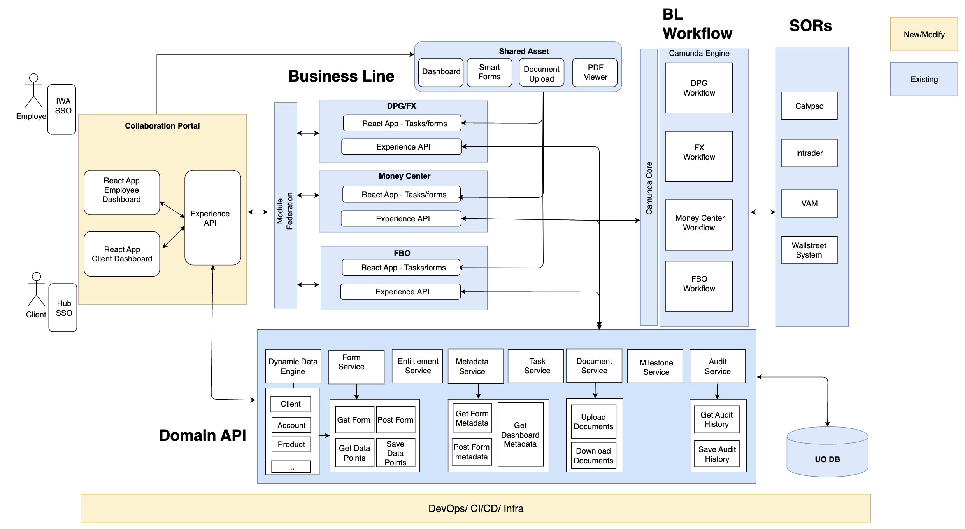
UO - Technical Design
UI Core Repo
API Core Repo

Slide 3
Unified Service Portal
unified-servicing-portal
(React app)
uo-ui-components
(Shared Assets)
unified-servicing-portal/src
onboarding/frontend
uo-usp-exp-api
(Exp API)
unified-servicing-portal/uo-microservices
uo-form-service
uo-event-service
uo-document-service
uo-entitlement-service
uo-audit-trail-service
uo-common-service
uo-metadata-service
uo-task-service
uo-form-service, uo-event-service ,..
(Domain API)
onboarding/uo-microservices
BPM Product Data
Unified Onboarding Data
GitLab: unified-servicing-portal
GitLab: onboarding

Slide 4
Project Structure – UO and USP
UO Project Structure
USP Project Structure
frontend (G)
  uo_ui_components (P)
  onboarding-portal (P)
  onboarding-client-portal (P)
  onboarding-employee-portal (P)
  …
  stitching-layer (G)
    fx- stitching-layer (P)
    gct- stitching-layer (P)
    …
uo_microservices (G)
  uo-dpg-exp-api (P)
  uo-pt-exp-api (P)
  uo-fx-exp-api (P)
  …
  uo-task-service (P)
  uo-document-service (P)
  uo-milestone-service (P)
  …
frontend (G)
  usp_service_portal (P)
  usp_ui_components (P)
  usp_ui_editor (P)
  …
  stitching-layer (G)
    usbi_stitching-layer
    …
usp_microservices (G)
  usp-exp-api (P)
  usp-commonobject-service (P)
  …

Slide 5
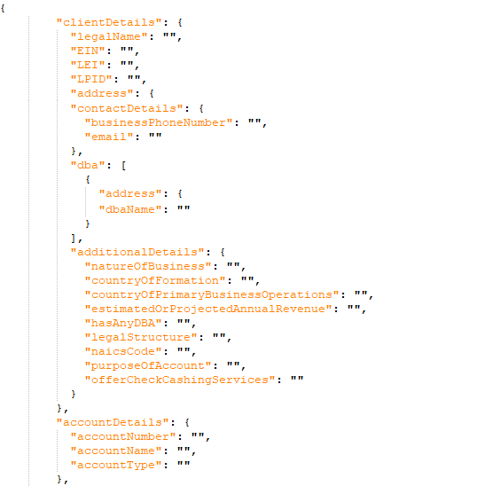
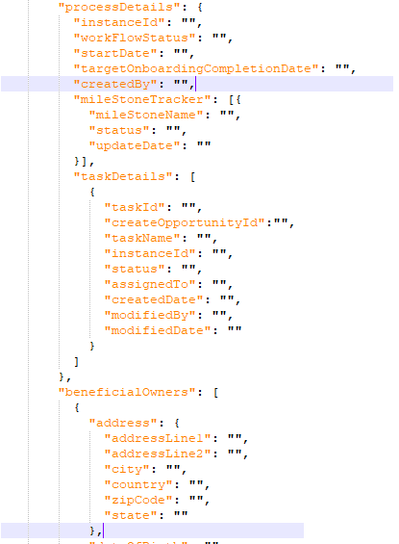
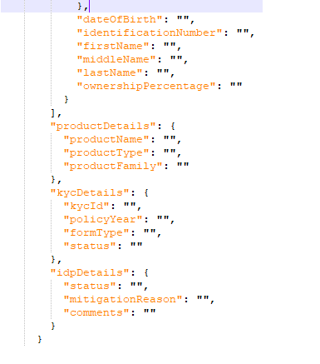
Common Object Details

Slide 6
Demo USP Current State

Slide 7
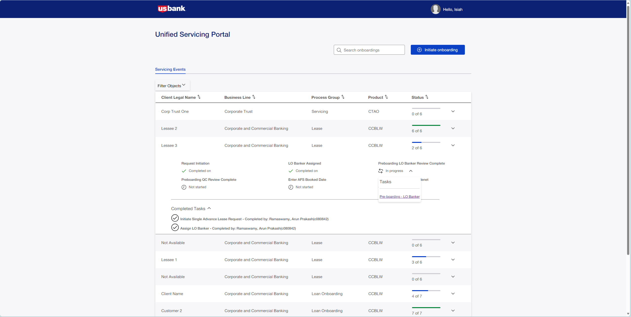
Unified Servicing Portal
With open task

Slide 8
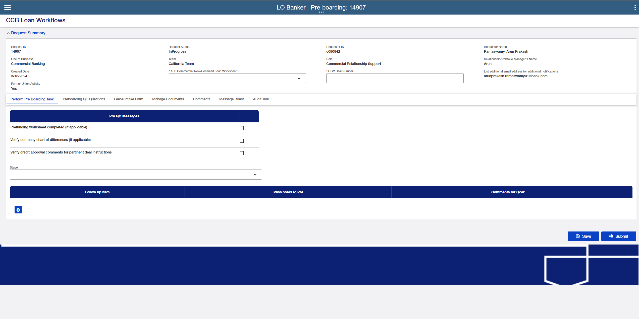

Slide 9

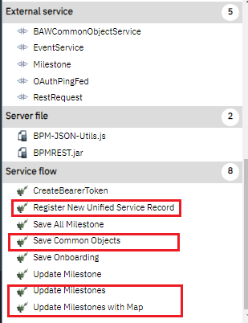
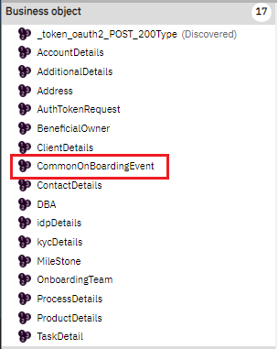
BAW Code : USP Integration - Toolkit

Slide 10
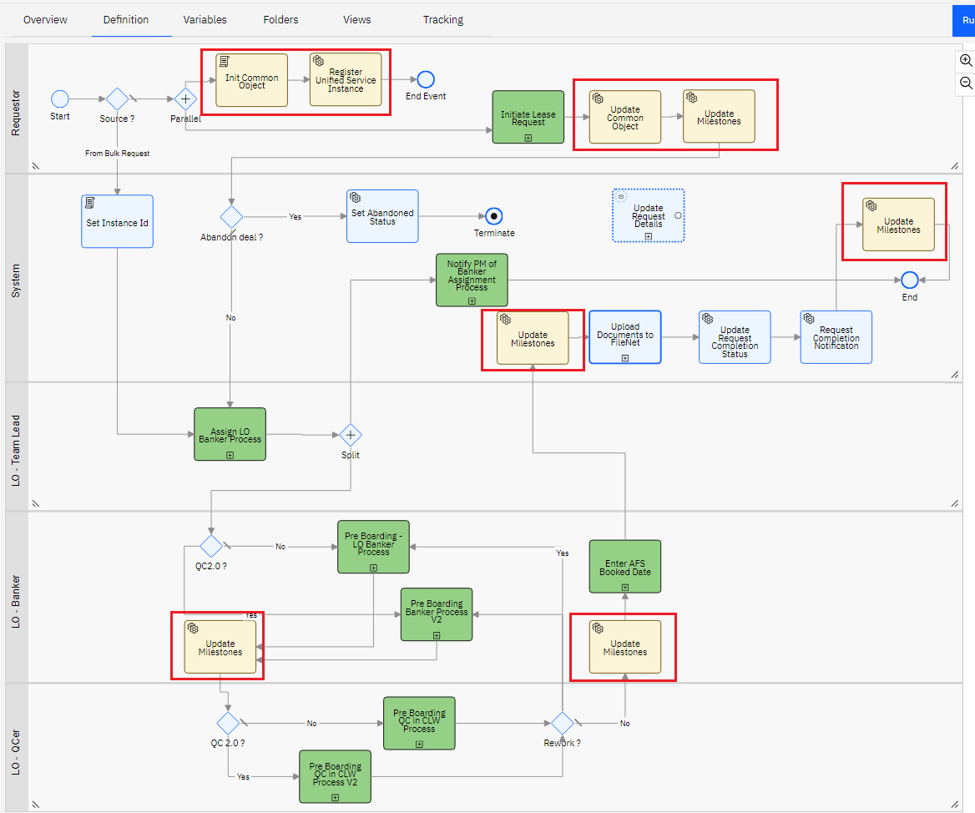
BAW Code : USP Integration – Process Updates

Slide 11
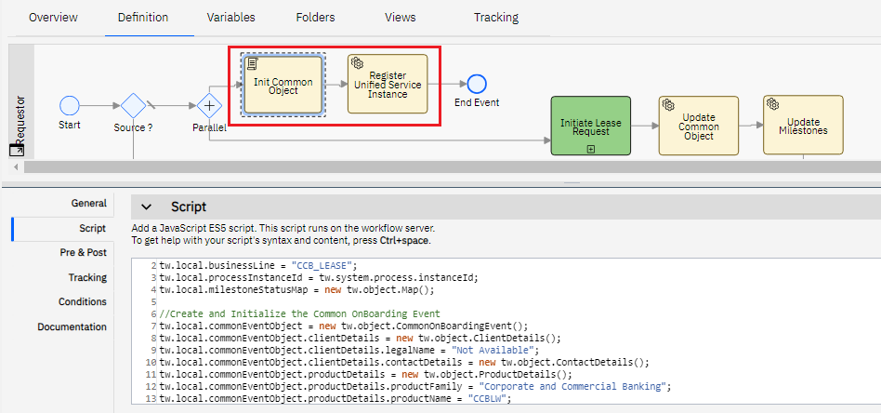
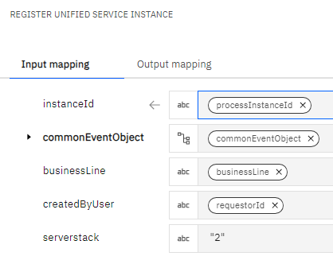
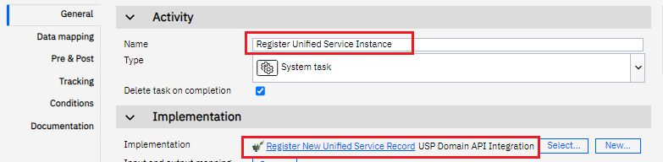
BAW Code : USP Integration – Register Unified Service Instance

Slide 12
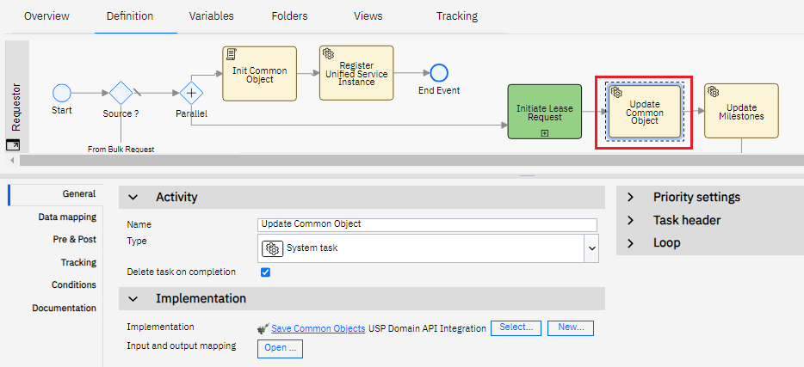
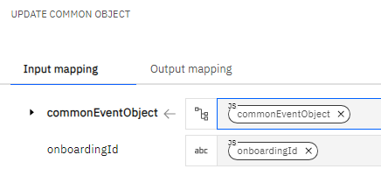
BAW Code : USP Integration – Update Common Object

Slide 13
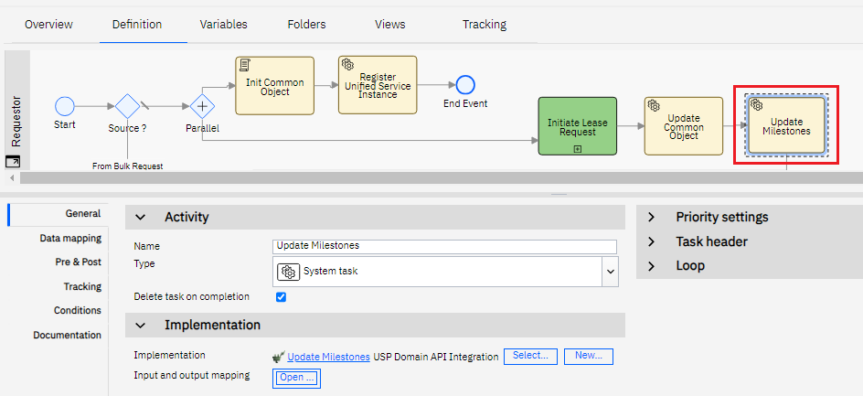
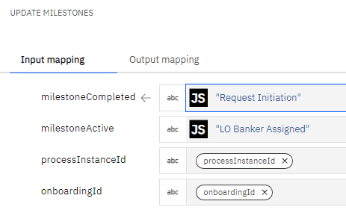
BAW Code : USP Integration – Update Milestones

Slide 14
Vision: Unified Servicing Portal Task Screens
BPM Corp Actions
Closed Deal File Checklist
Complex Assets Automation
USBI
SPQR
1. Dashboard
Task Tabs
Filtering
Request Details
Print
Reassign Task
Filenet
2. Task Manager
1. Dashboard
2. Analyst Task
1. Dashboard
Filenet
2. Valuation
SMONIK
Filenet
Dashboard
Custom Access
Print/Edit Request
Electronic File Upload
Filenet
2. Create Request
Phase 3
Upload Attachments
1. Initiate and Submit Request
2. Review Request
3. Perform Dual Authorization
4. Pend or Post Assets
3. Processor
Employee Service
GraphQL
SMTP
4. Second /Third Approver
Filenet
3. Banker Task
4. Supervisor Task
3. Incoming Transaction
Arcaria
Filenet
4. Outgoing Transaction
Arcaria
Filenet
3. eSign Receipt
Upload Attachments
3. Form Upload
Upload Attachments
5. Submit ACATS Delivery
6. Street Side Instructions
7. Settle/Super Settle Assets
8. Cancel Trades
5. Manage Memo Stationery
Create, Edit, Delete
Upload Attachments
6. Update Routing Policy
Create, Edit, Delete
5. Compliance Task
5. Perform Backdating
Filenet
6. Secondary Review
Filenet
4. Process Request
Upload Attachments
5. Advice Capture Request
Upload Attachments
3. Perform Asset Analysis
4. Post T2T Transactions
5. Process Global T2T Transfer
6. T2T Transfer Physical Assets
3. Review Receipt Instructions
4. Send Confirm ACATS
Shared Dashboard
5. Street Side Receipt
6. Confirm/Post Receipt
Common Screen
7. Additional Processing
8. Apply Cost Basis
Workflow 1
Workflow 2
9. Select Recipients and Send Statement
Workflow 3
Note: high-level diagram; limited workflows and integrations displayed
Notes:
Future state is to make all these workflows and screens accessible from one Unified Servicing Portal.
Our first focus is creating the shared dashboard.

Slide 15
Unified Servicing Dashboard
7
4
1
3
5
2
6

Slide 16
Screen Editor

Slide 17
USBI Dashboard
Dashboard
Manage Work
Tab UI
My Task
Team Task
All Request
All Interactions
…
Modal
Request Details
Tab UI
Business Details
Task Details
Documents
Screen UI
View Document

Slide 18
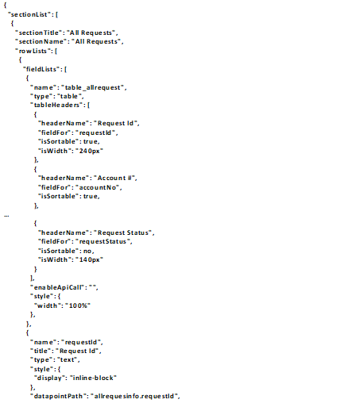
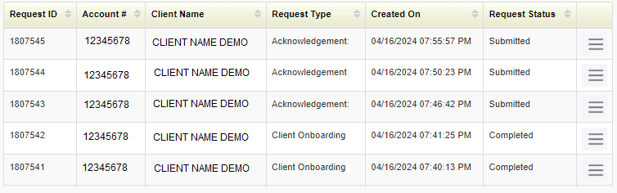



Update UI
UI Editor
Common Object
API
1
Update UI
UI Editor
Create UI
2
3
4
5
Application USBI
UI Dashboard
Section AllRequest_Tab
UI Component AllRequest_Table
$$<$$
$$<$$
$$<$$
$$<$$
UI Preview
6
Reset
Update

Slide 19

Create New UI
UI Editor
Common Object
API
Create UI
Update UI
UI Editor
Application Template
UI Task Manager
Section TabUI
UI Component Table
$$<$$
$$<$$
$$<$$
$$<$$
UI Preview
1
Create UI Confirmation
Personal Trust
Select Application
$$<$$
Create New Application
Section
2
Select UI Type
$$<$$
UI Name
PT_TaskReq_TableSection
Cancel
Save
3
Reset
Create

Slide 20
Appendix

Slide 21
CURRENT USBI DASHBOARD DATA

Slide 22
UO: GCT Application
onboarding-portal
(React app)
gct-stitching-layer
(React app)
uo-ui-components
(Shared Assets)
onboarding/frontend
onboarding/frontend/stitching-layer
onboarding/frontend
uo-gct-exp-api
(Exp API)
onboarding/uo-microservices
bpm-service
(BPM API)
uo-form-service, uo-event-service,…
(Domain API)
oboarding-core
(Core API)
onboarding
onboarding/uo-microservices
onboarding
uo-form-service
uo-event-service
uo-document-service
uo-entitlement-service
uo-audit-trail-service
uo-common-service
uo-metadata-service
uo-task-service
BPM Product Data
Unified Onboarding Data
Corporate Trust Data

Slide 23
UI JSON: Samples

Slide 24
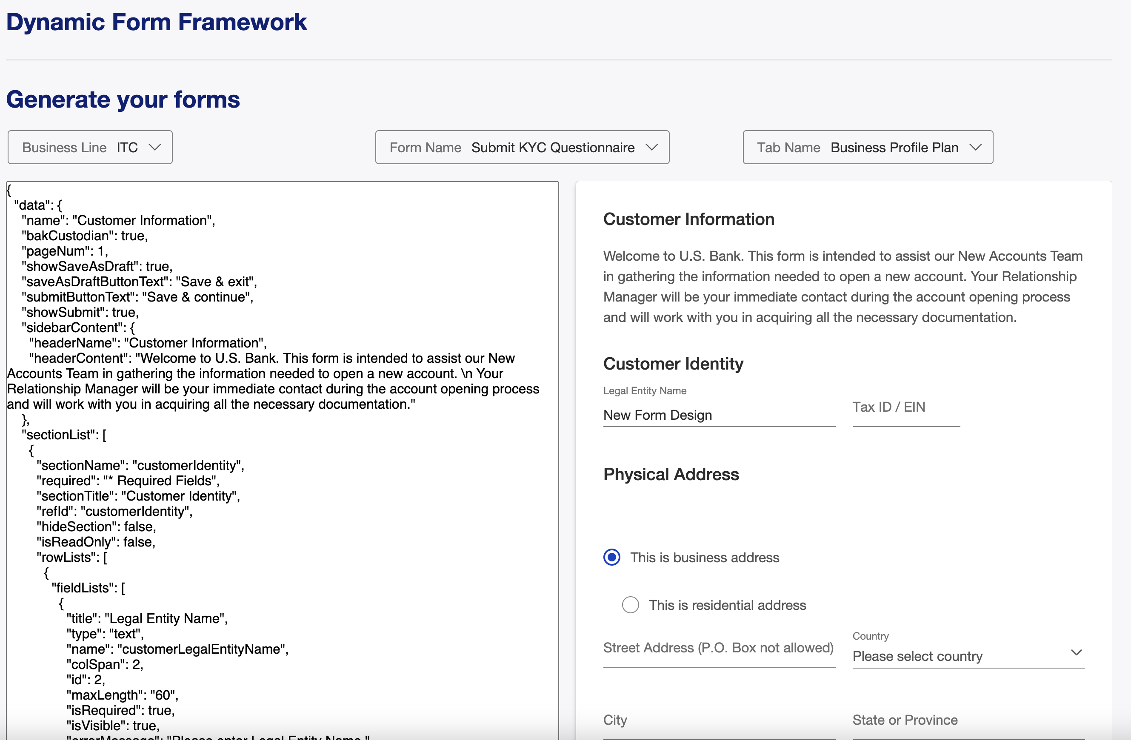
Dynamic Forms for Data Capture (Smart forms)

Slide 25
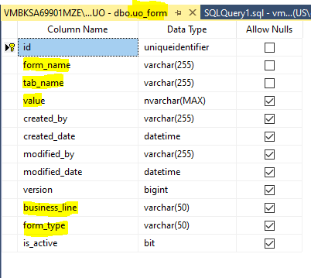
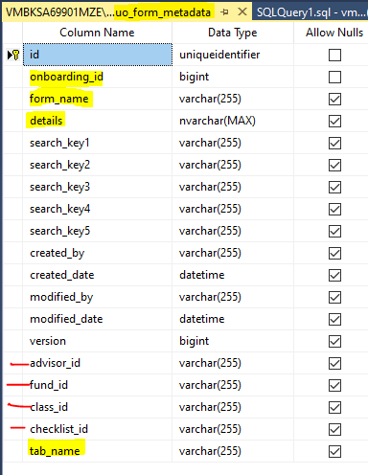
UO Form Table - Details
uo_form table can be utilized to store the screen json. As we progress, if more columns needs to be included then create new table.
  Form_name can be screen_name
Uo_form_metadata seems to beusing onboarding_id and other column that may not be relevant for us.

Slide 26
Design Considerations
The UI configuration(JSON) can be configured at screen, section and individual UI component level.
The user should be able to preview the UI at each levels i.e. screen, section and individual UI components.
  The configuration of the low-level components can also be referred using the section / ui component Id to keep the configuration clean and simple.
  By design, the system will not mandate to have a reference for low-level component. The application can decide on keeping all configuration in single JSON or separate configuration with reference.
The backend of the UI Editor will provide the flexibility for the application team to manage the UI JSON as
  Separate component (i.e. Left navigation, Action menu. Table, Filter…etc) and/or
  Section UI component (Tab UI, Modal, Tabs, Section…etc) and/or
  Complete single UI JSON with all the components

Slide 27
Table Design
USP_UI_DEFINITION
Columns | Note
Id | Unique Identifier
application_name | Template could be one of the application
ui_name | Name of the UI
value | JSON Value
ui_type | One of the type: UI / Section / Component
section_name | Section name is required if the ui_type is Section
ui_comp_name | UI Component name is required if the ui_type is Component
is_active | Only active ui_name will be displayed to the user in ui_editor
version | Track the number of changes to the ui (Auto incremented on each update)
created_by | For tracking
created_date | For tracking
modified_by | For tracking
modified_date | For tracking

Slide 28
Domain Services
New Domain service could be required for
USP UI Domain service could be required to manage the usp_ui_definition table i.e. insert, update and get.
Get the Data for UI Editor (Should be covered by above Domain Service) i.e.
  Application / Business Line configured for Dashboard
  UI name based on Application / Business line
  Section name based on the UI
  UI Components based on the Section name
  Retrieve the JSON based on the UI
Create new UI (Should be covered by above Domain Service) i.e.
  Create new application and associate with UI / Section / UI Component Json (Insert)
  Update UI / Section / UI Component Json
Preview logic will be implemented within the react app and the app will use the Domain service to retrieve the Json configuration.
  Service should also have logic to fetch the Json based on the reference id configured, so the preview can be complete.

Slide 29
Unified Servicing Dashboard
7
4
1
3
5
2
6

Slide 30
Unified Servicing Dashboard
7
4
1
3
5
2
This Header and Table is directly from USBI and will be using the Unified Onboarding Style
We are following The UO team's framework, this header is customizable in content and amount
6

Slide 31
Unified Servicing Dashboard
7
4
1
3
5
Tabs will be configurable and will only show to users that have access
2
6

Slide 32
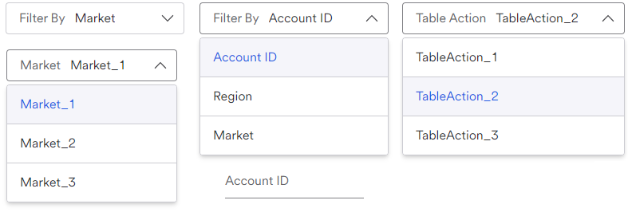
Unified Servicing Dashboard
7
4
1
This is an example of the market option is selected
Open Filter By dropdown example
3
5
6

Slide 33
Unified Servicing Dashboard
7
4
1
3
This is a way to have multiple filtered fields
5
2
6

Slide 34
Unified Servicing Dashboard
7
4
1
3
5
2
This is the custom sub row component. It can be customized to fulfill business needs. Currently we have it set up to display text/dropdown fields in rows of 3
6

Slide 35
Unified Servicing Dashboard
7
4
1
Table actions:
Actions only appear for users who have access.
If more data is needed to preform an action. A modal will appear.
3
5
2
6

Slide 36
Update UI
JSON Editor & Preview
Common Object
API
1
Create UI
Update UI
This option allows the user to update the UI for an existing application and template
JSON Editor and UI Preview
2
3
4
5
Application USBI
UI Dashboard
Section AllRequest_Tab
Component AllRequest_Table
$$<$$
$$<$$
$$<$$
$$<$$
UI Preview
6
Reset
Update

Slide 37
Update UI
JSON Editor & Preview
Common Object
API
1
Create UI
Update UI
JSON Editor and UI Preview
2
3
4
5
Application USBI
UI Dashboard
Section AllRequest_Tab
Component AllRequest_Table
$$<$$
$$<$$
$$<$$
$$<$$
All the existing application names and template are displayed
UI Preview
6
Reset
Update

Slide 38
Update UI
JSON Editor & Preview
Common Object
API
1
Create UI
Update UI
JSON Editor and UI Preview
2
3
4
5
Application USBI
UI Dashboard
Section AllRequest_Tab
Component AllRequest_Table
$$<$$
$$<$$
$$<$$
$$<$$
All existing UI screen configure for the application/template are displayed
UI Preview
6
Reset
Update

Slide 39
Update UI
JSON Editor & Preview
Common Object
API
1
Create UI
Update UI
JSON Editor and UI Preview
2
3
4
5
Application USBI
UI Dashboard
Section AllRequest_Tab
Component AllRequest_Table
$$<$$
$$<$$
$$<$$
$$<$$
All the sections configured for application / template selected is displayed.
UI Preview
6
Reset
Update

Slide 40
Update UI
JSON Editor & Preview
Common Object
API
1
Create UI
Update UI
JSON Editor and UI Preview
2
3
4
5
Application USBI
UI Dashboard
Section AllRequest_Tab
Component AllRequest_Table
$$<$$
$$<$$
$$<$$
All UI is displayed based on the application / template and section selected
$$<$$
UI Preview
6
Reset
Update

Slide 41
Update UI
JSON Editor & Preview
Common Object
API
1
Create UI
Update UI
JSON Editor and UI Preview
2
3
4
5
Application USBI
UI Dashboard
Section AllRequest_Tab
Component AllRequest_Table
$$<$$
$$<$$
$$<$$
$$<$$
UI Preview
6
JSON is loaded based on the dropdown value selected. User can update the JSON to view the preview and update the JSON back to backend.
Reset
Update

Slide 42
Create New UI
JSON Editor & Preview
Common Object
API
Create UI
Update UI
JSON Editor and UI Preview
Application Template
UI Task Manager
Section TabUI
Component Table
$$<$$
$$<$$
$$<$$
$$<$$
UI Preview
1
Create UI Confirmation
If creating UI for existing application, select the application name from dropdown
Personal Trust
Select Application
$$<$$
Create New Application
Section
2
Select UI Type
$$<$$
UI Name
PT_TaskReq_TableSection
Cancel
Save
3
Reset
Create

Slide 43
Create New UI
JSON Editor & Preview
Common Object
API
Create UI
Update UI
JSON Editor and UI Preview
Application Template
UI Task Manager
Section TabUI
Component Table
$$<$$
$$<$$
$$<$$
$$<$$
UI Preview
1
Create UI Confirmation
Personal Trust
Select Application
$$<$$
Create New Application
Section
2
Select UI Type
$$<$$
Select One of the UI type i.e., UI / Section / Component
UI Name
PT_TaskReq_TableSection
Cancel
Save
3
Reset
Create

Slide 44
Create New UI
JSON Editor & Preview
Common Object
API
Create UI
Update UI
JSON Editor and UI Preview
Application Template
UI Task Manager
Section TabUI
Component Table
$$<$$
$$<$$
$$<$$
$$<$$
UI Preview
1
Create UI Confirmation
Personal Trust
Select Application
$$<$$
Create New Application
Section
2
Select UI Type
$$<$$
UI Name
PT_TaskReq_TableSection
Cancel
Save
3
Click on Save to create new UI and associate it with the application & UI type
Reset
Create

